Slide 1

ONLINE PIZZA ORDER SYSTEM
BY
STUDENT NAME : 1) Mujumdar Girish
2) Sarode Yogesh
GUIDE NAME: Milind Arjun sir

Slide 2
Project Name
ONLINE PIZZA ORDER SYSTEM

Slide 3
ABSTRACT
The online pizza ordering system can be use by customers to purchase pizza online, without having to go to the Pizzavala shop.
This system is enabled by the internet which connects the pizzeria or the food company and the customer.
As per this system, the customer visits the website, browses through the various pizzas, combos and cuisines available there and selects and purchases the items he or she needs.
These items will then be delivered to the customer at their doorsteps by a delivery person.

Slide 4
. INTRODUCTION
The Online Pizza Ordering System is a program that will be capable of inputting data and retrieving data to support the ordering process.
The program will have all necessary flavors of pizza types, and pizza ingredients.The Online pizza Ordering System is the typical ordering and delivery retrieval system.How the program would work in typical conditions is a customer or employee would access the database and enter the required information.
The goal of the program is to develop a data collection that would allow new customers to input their personal data ( name, address, number, email )

Slide 5
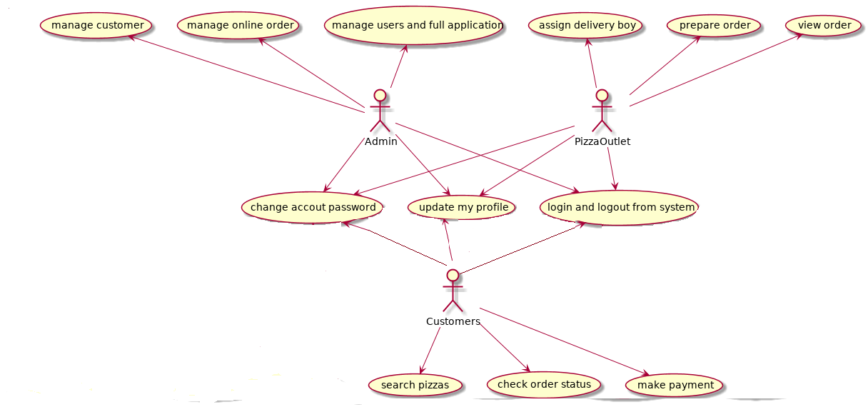
Use Case Diagram:-

Slide 6
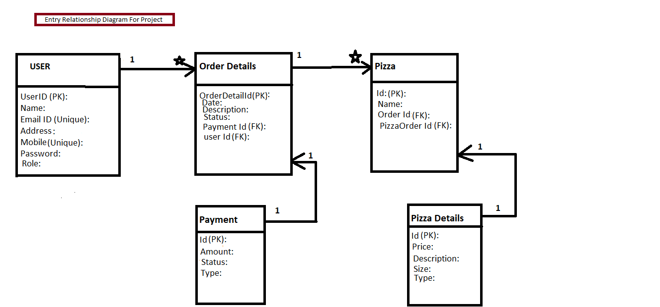
ER Diagram:-

Slide 7
Purpose
Login For Admin
manage menu list
manage orders
add the products to the menu list
edit the existing Products of menu list
Customer Login
Customer Registration
Customer cart
customer Order confirmation

Slide 8
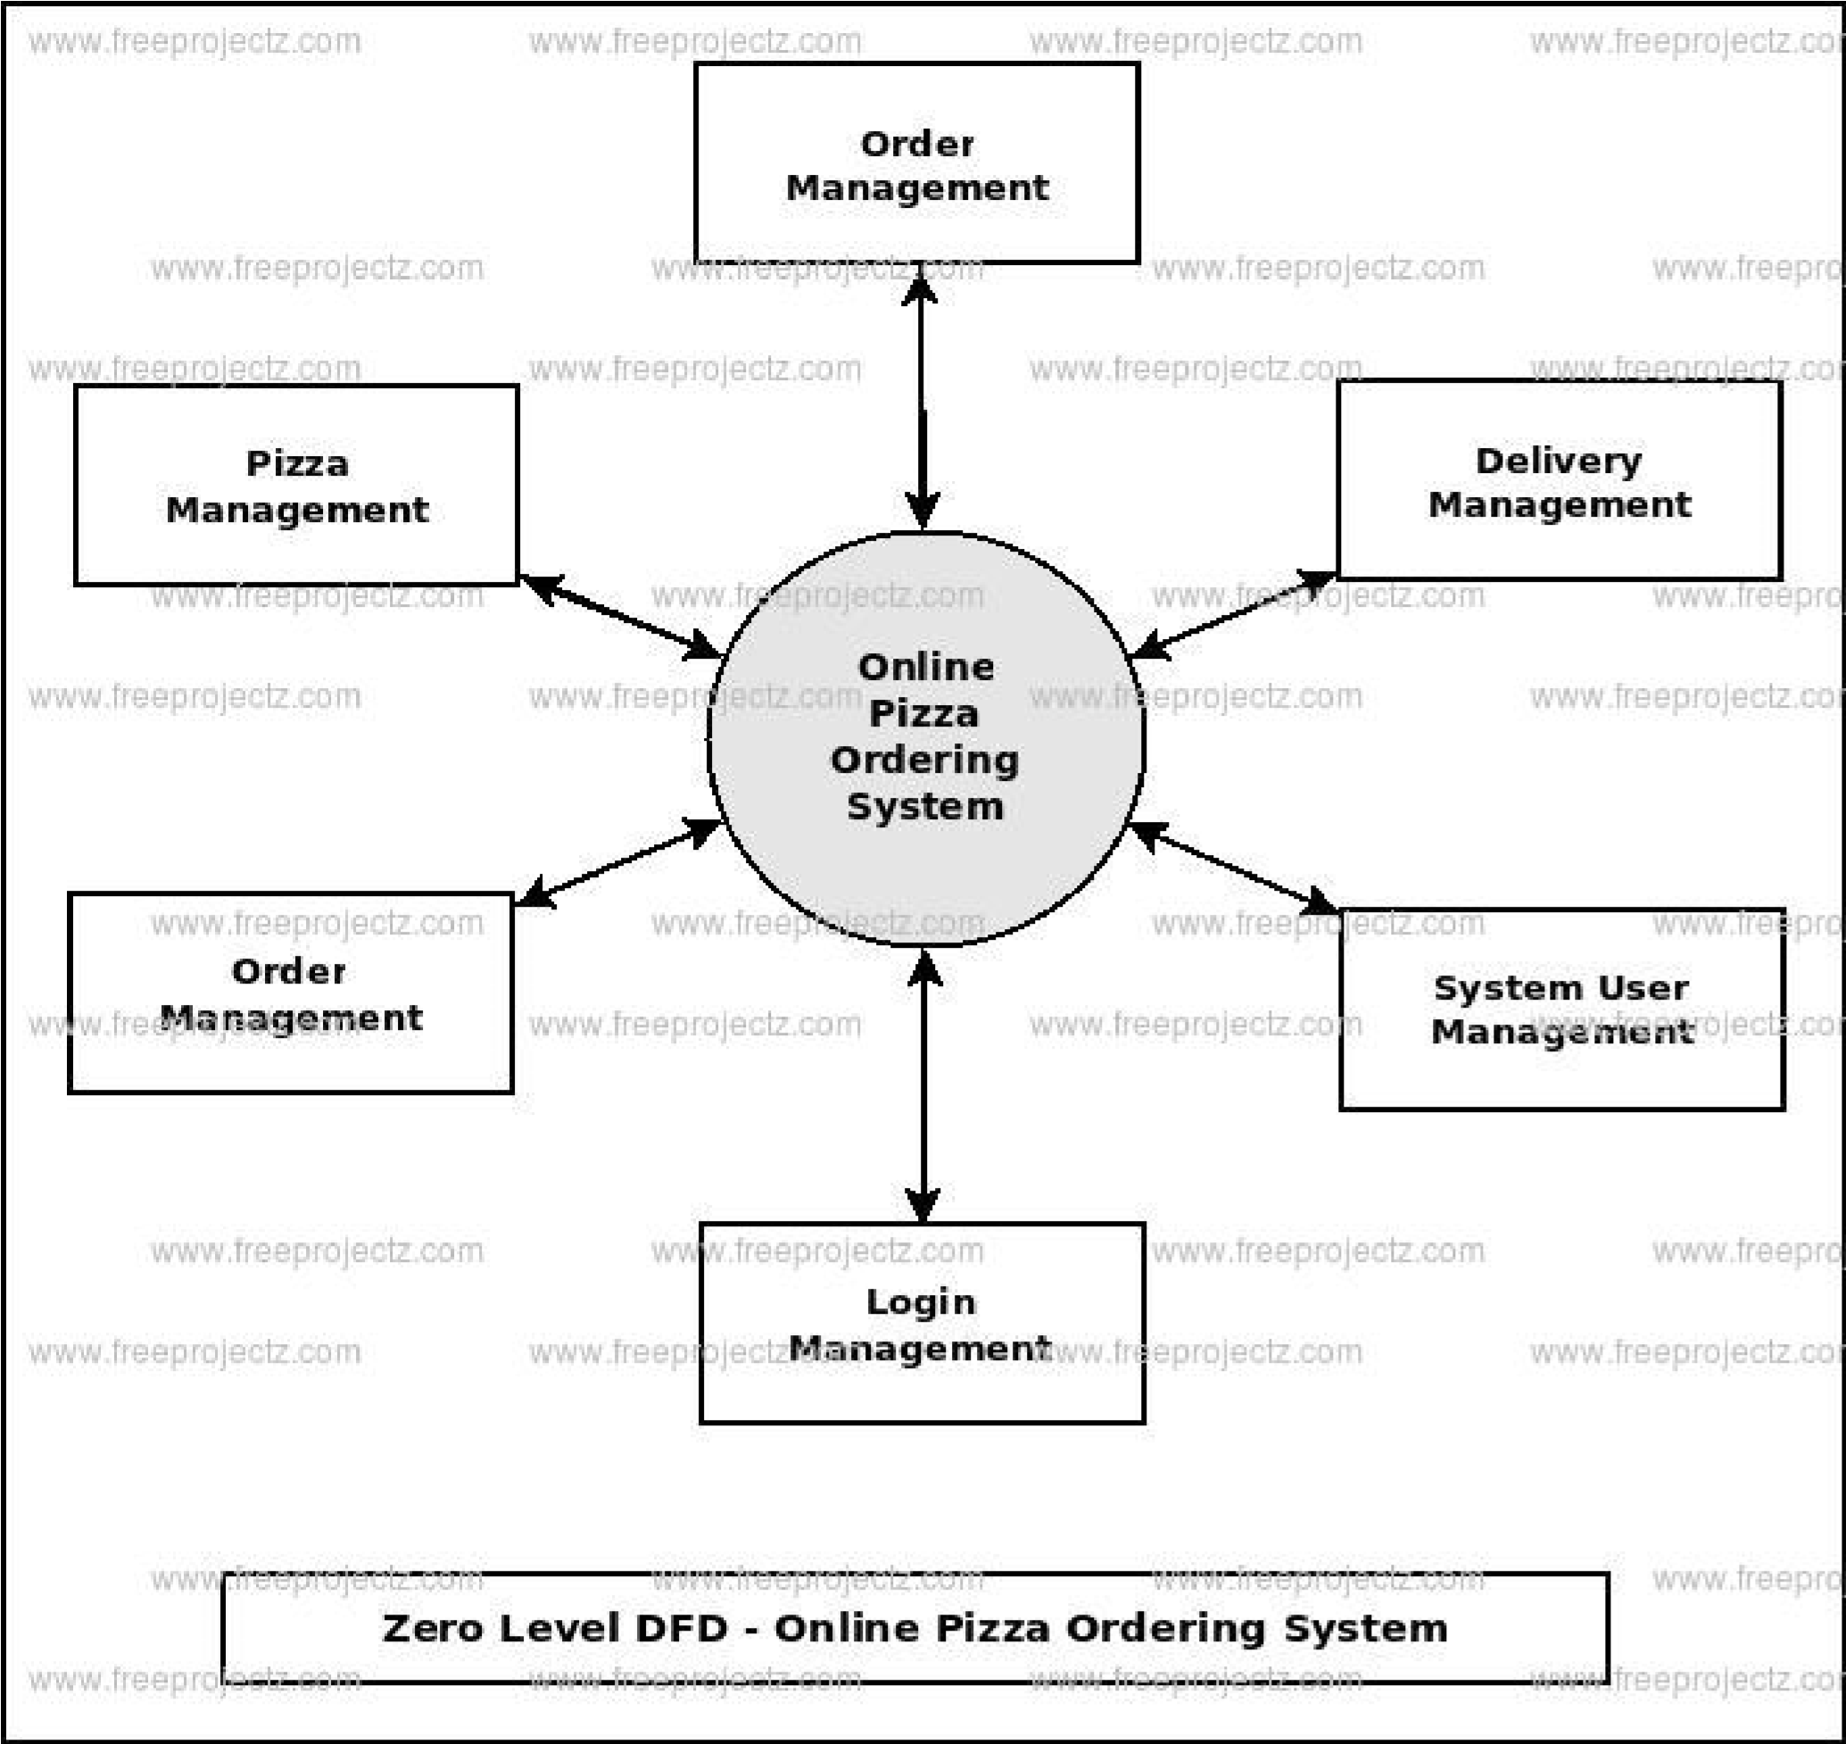

Slide 9
Scope
Online Pizza ordering system will be a web based application whose main language of programming will be Java.
Its main aim is to simplify and improve the efficiency of the ordering process for both customer and pizza shop owners, minimize manual data entry and ensure data accuracy and security during order placement process. Customers will also be able to view product menus and their ingredients and be able to have a visual confirmation that the order was place correctly

Slide 10
FEATURES
Online menu.
Provision of restaurant owners to perform various operations like add, edit, update the menu items.
Easy lookup of registered user on portal.
Simple, fast and convenient ordering of food.
Availability of the menu online 24x7.
An online menu is ready to be viewed by people worldwide.

Slide 11
BENEFITS
The rich variety of online websites makes customers do their wishes very quickly where this website helps to add products easily to cart for customers and admin Admin section also admin can manages the menu list of the User Interface where admin can the add new products to the list and also update the product list and also can delete the products which admin don’t want to keep it in a menu list this system will helps to user and admin to do a functions in a easy manner. This website will contains function such as add to cart,viewing menu,etc

Slide 12
CONCLUSION
After reviewing our work, the conclusion is that after many adjustments the system works. As good as it is now, there can still be made many adjustments/improvements. However in the time was given that two persons can work on this project, the overall results are satisfactory in our opinion. The report covers the entire course of the project and results are there were needed. This conclusion chapter is more a description of the process rather than a summary to give all results and facts.
The first few days the work progressed slower than expected, in the last days the pace was increased to finish on time. At several moments, the progress and pace was commented on that "the progress was not good". The results of this report should be sufficient evidence that work was done properly.
The conclusion as it is now hopefully gives a understanding in the steps taken to make the report.

Slide 13
SOFTWARE REQUIREMENT
1. Windows 10
2.SQL Database
3. Spring Tool
4. Visual Studio
HARDWARE REQUIREMENT
1.Processor – i3
2.Ram – 8 GB
3. Memory- 1TB

Slide 14
REFERENCES
https://www.dominos.co.in/ https://www.pizzahut.co.in/ http://w3schools.com/ https://getbootstrap.com/docs/5.0/getting-started/introduction/

Slide 15
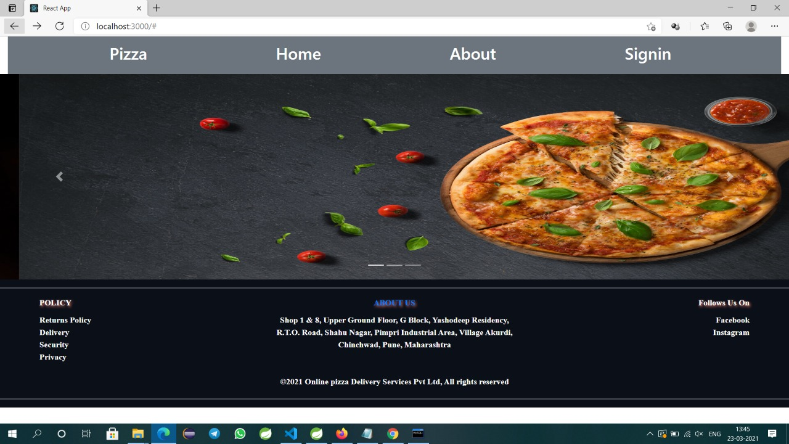

Slide 16
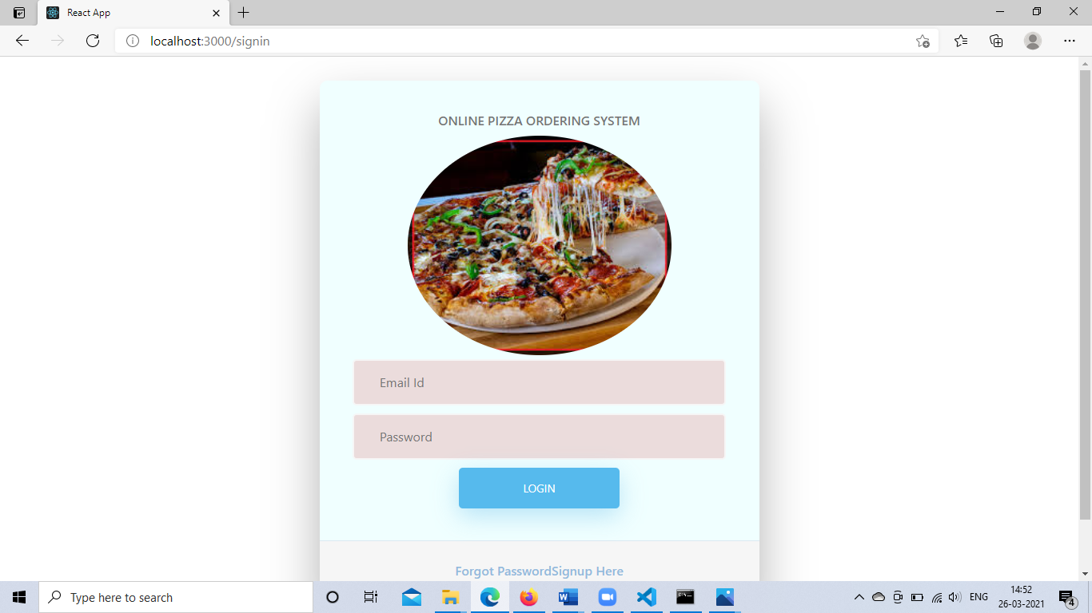

Slide 17
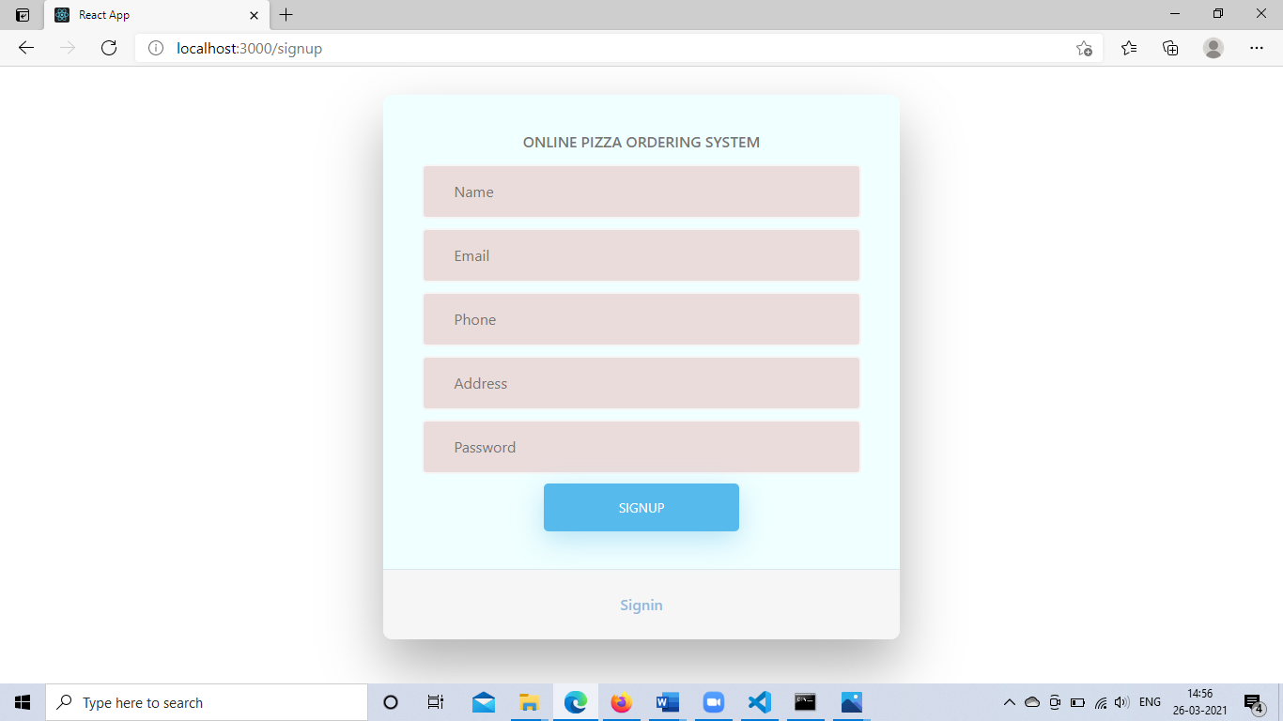

Slide 18
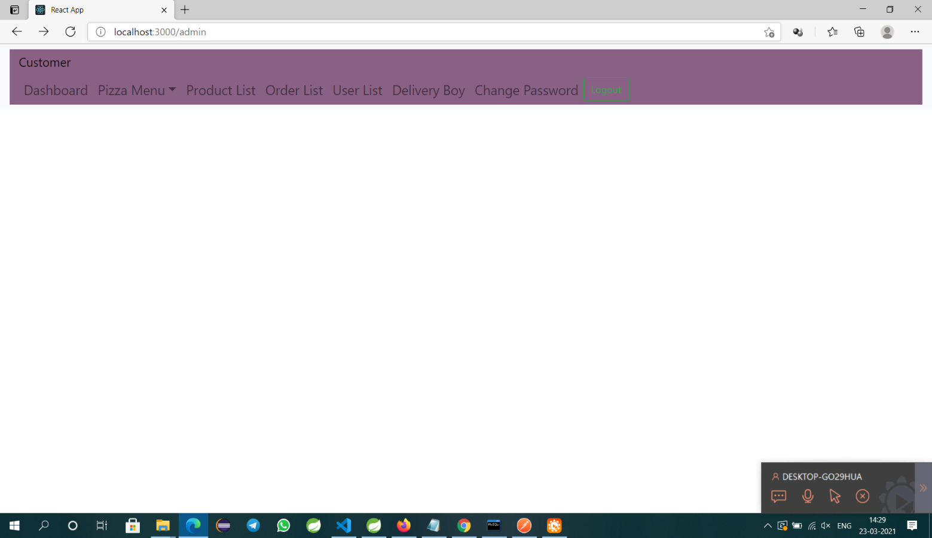

Slide 19
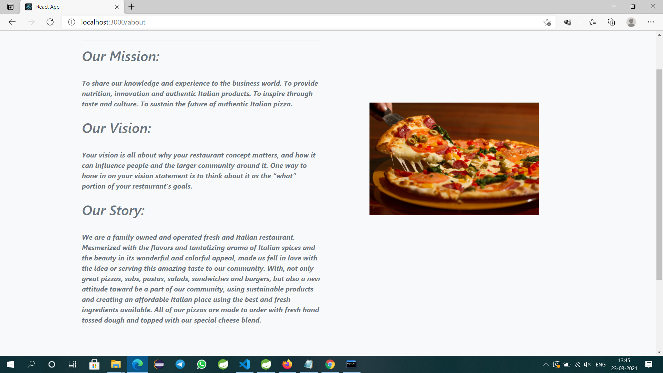

Slide 20
THANK YOU

